Slide 1
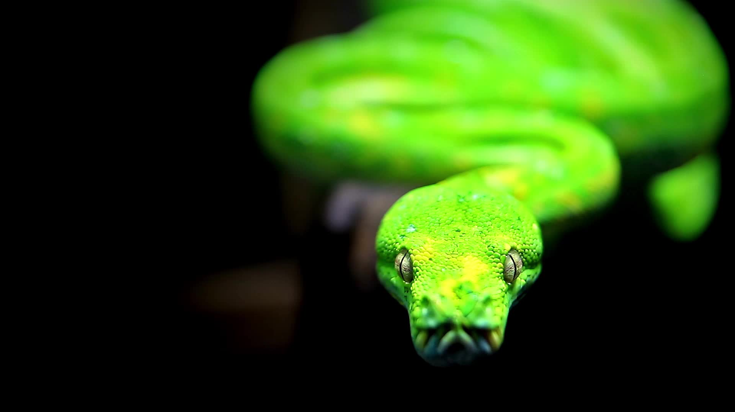
Python! Day 8
Functions! In more depth

Slide 2
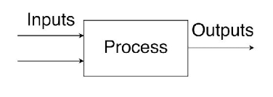
Functions: Inputs and Outputs
So far, we’ve been using a lot of functions that are built into Python,
like, print(), input(), str(), and random.randint()
We’ve also used functions that we’ve created ourselves,
like adventure_program() and draw_box_program()
One thing that built-in Python functions can do that ours can’t is take inputs and give outputs
For example, random.randint() takes inputs of the minimum and maximum numbers that the function can generate and gives an output of a random number

Slide 3
random_number = random.randint(1, 6)
The number inside the random_number variable is the output of the function, also known as the function’s return value
These numbers are the inputs to the function, also known as the function’s parameters
Note: A function can have any number of inputs, but it can only have 0 or 1 outputs

Slide 4

Functions: Parameters
We can add parameters, or inputs, to a function like this:
def function_name(parameter_name):
# do this
print(paramer_name)
For a simple function that adds two numbers together, this would look like this:
def sum(a, b):
print(a + b)
sum(2, 6)

Slide 5

Improve Draw Box Program
We can improve the draw box program by adding a parameter indicating how tall the box will be
This might look something like this:
def draw_box_program(box_height): lid = "-------" print(lid) for n in range(0, box_height, 1): print("| |") print(lid)
Now we can print a whole bunch of different-sized boxes in a row

Slide 6

Functions: Return Values
We can add return values, or outputs, to a function like this:
def function_name():
return return_value
In the sum() function from earlier this might look like:
def sum(a, b):
value = a + b
return a + b
print(sum(a + b))

Slide 7

Improve Coin Flip Program
We can improve our coin flip program by making it return the result of the coin flip instead of just printing it
This might look like:
def flip_coin_program():
random_number = random.randint(0, 1)
if random_number == 0:
return “heads”
else:
return “tails”

Slide 8

Project: Luck Analyzer
Let’s use our new coin flip function to create a program that asks that user “heads or tails” and calls the coin flip function 10 times
Then, based on how many coin flips matched the user’s input, the program will analyze how lucky the user is

Slide 9
def luck_analyzer_program(num_coin_flips):
user_guess = input(“heads or tails? ”)
coin_flips = []
for n in range(0, num_coin_flips):
coin_flips.append(flip_coin_program())
print(coin_flips)
int num_wins = 0
for n in coin_flips:
if n == user_guess:
wins += 1
luck_score = int(num_wins / len(coin_flips)) * 100
print(“Your luck score is ” + str(luck_score))

Slide 10
To conclude the lesson on functions, let’s count how many times we use a function in our luck analyzer program
def luck_analyzer_program(num_coin_flips):
user_guess = input(“heads or tails? ”)
coin_flips = []
for n in range(0, num_coin_flips):
coin_flips.append(flip_coin_program())
print(coin_flips)
int num_wins = 0
for n in coin_flips:
if n == user_guess:
wins += 1
luck_score = int(num_wins / len(coin_flips)) * 100
print(“Your luck score is ” + str(luck_score))

